Slide 1



Slide 2
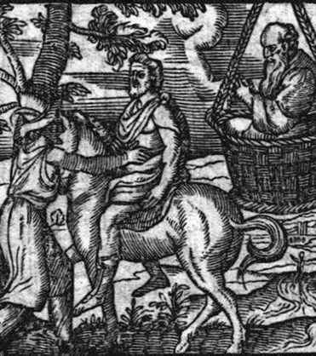
‘Kids today, with their long hair, sports gambling…
…they’re nothing like us old-timers who worked the fields, went to war…’
  From “Clouds”—a comedy, by Aristophanes, 423 BC

Slide 3

More recently, from New Zealand…

Slide 4
Working across age groups can be: transactional
Watch: “Grandkids = Free Tech Support”
Ally Bank TV spot, “Facts of Life: Tech Support” (via iSpot.tv)

Slide 5
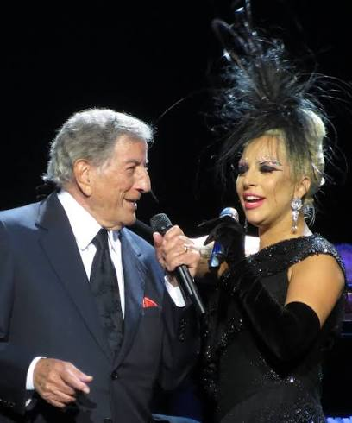
Working across age groups can be: harmonious
Tony Bennett (88) & Lady Gaga (28)
Album: “Cheek to Cheek” (Columbia, 2014)
Debuts at #1 on the Billboard 200 chart
Photo: marcen27, via Wikimedia Commons, CC BY 2.0

Slide 6
Five points about working across age groups
Working across age-groups, is an age-old activity
  Hard-wired into our DNA
You can make things worse by fixating on, or over-compensating for assumed ‘generational’ differences
‘Generational’ approach (e.g. Boomer, Millennial) is only one way of managing and leading across age groups
  Convenient, fun, but w/significant limitations—inaccurate stereotyping; empirical research support is weak
Good alternatives/supplements are available
  Life stage approach (Erikson)
  Lifespan approach (Baltes)
The most important approach will always be yours
  Research will only take you so far
  Have confidence in your own approach, even as you improve it

Slide 7
Working Across Generations

Slide 8
What is a “generation”?
A cohort of people, shaped by historical events, esp. in formative years—late teens to early 20s (Karl Mannheim, 1920s)
  Wars (WWII, Vietnam)
  Economic upheaval (1929 Crash & Depression)
  Rise of Internet/Social Media
  Pandemics (SARS, COVID)
Originally, not just age groupings
2010s: Pew Research adds the now-familiar labels and birth-year ranges, e.g. “millennial,” “boomer,” etc.

Slide 9
Six generations, spanning roughly a century
Silent: Born 1928-1945, ages 80-97
Baby Boomer: Born 1946-1964, ages 61-79
Gen X: Born 1965-1980, ages 45-60
Millennial: Born 1981-1996, ages 29-44
Gen Z: Born 1997-2012, ages 13-28
Alpha: Born 2013-2025, ages 1-12

Slide 10
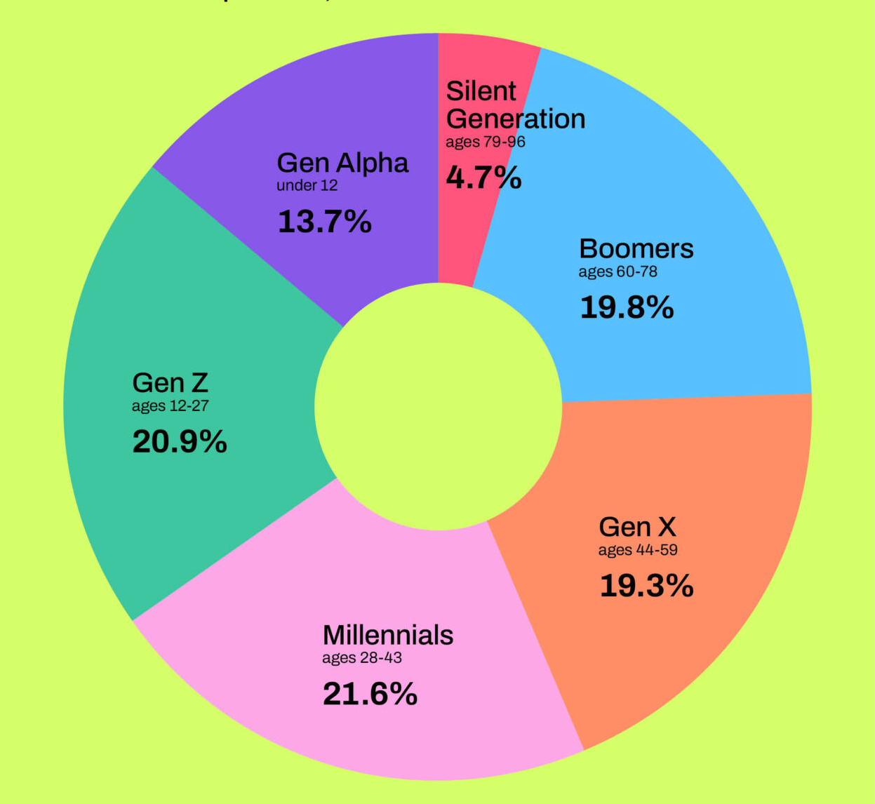
U.S. Population, by generation, 2024
Source: Pew Research, from US Census data

Slide 11
U.S. Workforce, by generation, 2025
Source: Pew Research, Bureau of Labor Statistics

Slide 12
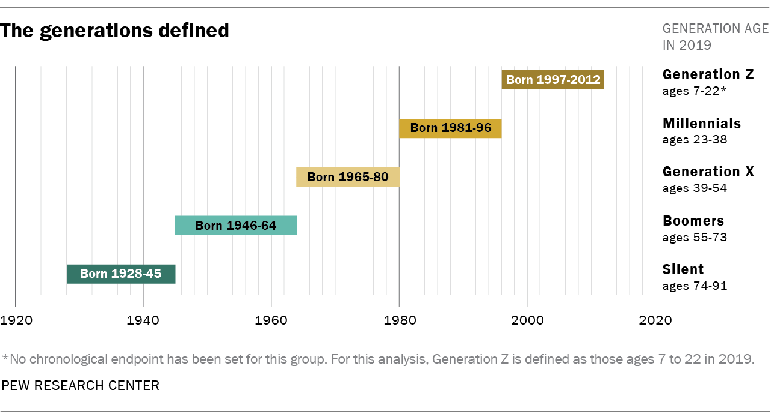
Four generations active in the workplace—notable but not unprecedented

Slide 13
Potential points of conflict: older vs. younger (Ozolina et al, 2024; 1 of 2)
‘Communication’ styles
  Direct and F2F, vs. Indirect (digital—instant messaging)
Work/Life Balance Expectations
  Value stability and security vs. flexibility and personal fulfillment
Speed and Scope of Technology Adoption
Career Advancement
  Value long-term tenure vs. flexibility and experiential/entrepreneurial opportunity
Work Ethic Perceptions
  Value dedication, punctuality, structure vs. work/life balance, outcomes over process

Slide 14
Potential points of conflict: older vs. younger (Ozolina et al, 2024; 2 of 2)
Authority and Hierarchy
  Hierarchical structures and seniority vs. flatter orgs and collaboration
Conflict Resolution
  Structured process vs. collaborative problem solving
Learning and development
  In-person workshops vs. digitally delivered, ‘bit-size’ modules
Recognition and Rewards Expectations
  Longer-term recognition for tenure, promotions vs. more frequent and immediate recognition

Slide 15
“Hold up!” says my Gen Z son...
Supporting data for generational categories is not strong
  Differences within generations are larger than differences between generations [Rudolph]
Generational labels bring stereotypes and ‘meta-stereotypes’
  “OK, Boomer,” “Luddite,” “GenMe” or “Snowflake” (Millennial), “Slacker” (Gen X) “Slacktivist” (Gen Z)
  ‘Meta Stereotypes’: What we assume, about what others assume, about us
Generational labels are oversimplified
  Generational differences blamed for everything from the decline of baseball, to the decline of sales of American (processed) cheese
  Generational events are often culture/geography-specific
Generational labels are self-fulfilling prophecy
  Generational labels create/propagate the divide between generations [Hirsch, King]

Slide 16
If ‘generational’ categories are problematic…
Yet working across them is the norm for most workplaces…
What are some alternatives?

Slide 17
Working Across Life Stages
(Erikson)

Slide 18
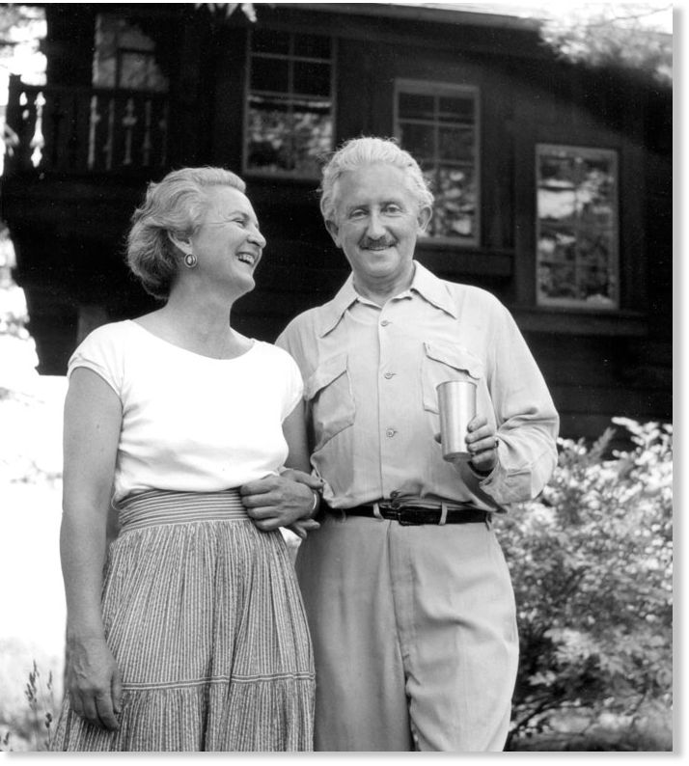
Joan & Erik Erikson
c. 1950

Slide 19
Erikson(s): Psychological development unfolds through eight stages
8. Late Adulthood ( 65+)
Integrity (+)
Despair (-)
7. Middle Adulthood (40 – 65)
Generativity (+)
Stagnation (-)
At each stage, we face a crisis, e.g. “identity crisis” in the “Adolescence” stage
Successful handling of the crisis (“+” in green) leads to psychological growth and maturation, in this case: clear self-identity
Unsuccessful handling (“-” in yellow ) leads to “role confusion”
Stage 7 Middle Adulthood
  (+) “Generativity” defined as “concern in establishing and guiding the next generation”
  (-) “Stagnation” or “Self-Absorption”
6. Young Adulthood (18 – 40)
Intimacy (+)
Isolation (-)
5. Adolescence (12 – 18)
Identity (+)
Role Confusion (-)
4. School Age (6 – 12)
Industry (+)
Inferiority (-)
3. Play Age (3 – 6, pre-school)
Initiative (+)
Hesitation (-)
2. Early Childhood (1.5 – 3)
Autonomy (+)
Doubt (-)
Infancy (0 – 1.5)
Trust (+)
Mistrust (-)

Slide 20
Another good alternative:
Working Across a Lifespan
(Baltes)

Slide 21
Working Across a Lifespan
Developmental Psychology
  Paul Baltes (1939-2006)
Main idea: Don’t categorize people
  Focused on the individual
  No ‘generation,’ no fixed ‘life stages’
  Age and history are influences on a person, not categories for a person
Core assumptions
  Every lifespan and trajectory is unique
  Development continues throughout life, with gains and losses at every age
  People remain capable of change at any age
  Differences between people grow larger with age

Slide 22
Working Across a Lifespan
Three sources of influence
  Age-related: e.g. school, first job, retirement
  Historical: e.g. wars, recessions, the internet
  Personal: e.g. illness, job loss, a lucky break
Strength and effects differ by person, and by age
  Example: A recession
    22-year-old: Delays their career start
    50-year-old: They lose a job they’ll never fully replace
    60-year-old: Pushed into early retirement

Slide 23
Three Approaches for Working Across Age Groups
 | Generational (Mannheim; Pew) | Life Stage (Erikson) | Lifespan (Baltes)
In a nutshell | “History shapes us” | “Life stage defines us” | “My path shapes me”
Focal point | Group—Generational cohort | Individual + Fixed Life Stages | Individual + Unique Context
Risk of Stereotyping | Highest | Lower | Lowest
Developmental effort required of mentor | Lowest | Higher | Highest
Developmental Potential for mentee | Lowest | Higher | Highest

Slide 24
Caution: Stereotyping happens quickly!
Two dimensions which account for initial reactions and stereotyping in everyday social situations (Fiske et al)
  Warmth
    Perceived intent, encompassing trustworthiness, friendliness, and sociability, e.g., “friend or foe?”
  Competence
    Perceived ability to act on that intent, encompassing capability, assertiveness, and efficacy
Warmth and competence can account for as much as 82% of initial perception in everyday social situations

Slide 25
First impressions and stereotypes can form in as little as 20ms
Warmth: H
Pity
(Stereotypes of the elderly)
Admiration
(In-groups, allies)
Competence: L
Competence: H
Contempt
(Dehumanized groups, e.g. homeless)
Envy
(Competitive out-groups, wealthy elites)
Warmth: L

Slide 26
Likely (default) impressions of younger vs. older, and vice versa
Warmth: H
Younger➔Older*
“Kind but slow,” “Grandpa”
Younger➔Older
“Wise”
Older➔Younger*
“Green” “Pup”
Older➔Younger
“Star” “Respect”
Competence: L
Competence: H
Younger➔Older
“Dinosaur”
Younger➔Older
“Political” “Sly” “Boss”
Older➔Younger
“Slacker”
Older➔Younger
“Reckless” “Hot Shot”
Warmth: L
* = Default; most commonly observed

Slide 27
Five points about working across age groups
Working across age-groups, is an age-old activity
  Hard-wired into our DNA
You can make things worse by fixating on, or over-compensating for assumed ‘generational’ differences
‘Generational’ approach (e.g. Boomer, Millennial) is only one way of managing across age groups
  Convenient, fun, but w/significant limitations—inaccurate stereotyping; empirical research support is weak
Good alternatives/supplements are available
  Life stage approach (Erikson)
  Lifespan approach (Baltes)
The most important approach will always be yours
  Research will only take you so far
  Have confidence in your own approach, even as you improve it

Slide 28
Six recommendations for Working Across Age Groups
Assume, at least initially, the good intentions of your counterparty
Consider, in order: First, their unique situation, then their life/career stage, then their generational cohort
Remember the meaning of ‘work’ itself changes over a lifetime
Be mindful of the ‘anchoring’ of first impressions
Good managers and leaders, to the extent possible, always know their people, as unique individuals
Ultimately, you will find (in others) what you’re looking for (in others)!

Slide 29

Selected references
Baltes, Paul B. "Theoretical propositions of life-span developmental psychology: On the dynamics between growth and decline." Developmental psychology 23.5 (1987): 611.
Fiske, Susan T., Amy JC Cuddy, and Peter Glick. "Universal dimensions of social cognition: Warmth and competence." Trends in cognitive sciences 11.2 (2007): 77-83.
Hirsch, Peter Buell. "Follow the dancing meme: Intergenerational relations in the workplace." Journal of Business Strategy 41.3 (2020): 67-71.
Howe, Neil, and William Strauss. Millennials rising: The next great generation. Vintage, 2000.
Inglehart, Ronald. The silent revolution: Changing values and political styles among Western publics. Princeton University Press, 2015.
King, Eden, et al. "Generational differences at work are small. Thinking they’re big affects our behavior." Harvard Business Review 1 (2019): 1-7.
Lukianoff, Greg, and Jonathan Haidt. The coddling of the American mind: How good intentions and bad ideas are setting up a generation for failure. Penguin, 2019.
Mannheim, Karl. "The sociological problem of generations." Essays on the Sociology of Knowledge 163 (1952): 95.
Ozolina, Jana, Sanita Saitere, and Elina Gaile-Sarkane. "Bridging Generational Gaps: Reducing Conflict and Enhancing Collaboration in the Workplace.“ 2024
Rudolph, Cort W., et al. "Generations and generational differences: Debunking myths in organizational science and practice and paving new paths forward." Journal of Business and Psychology 36 (2021): 945-967.

