Slide 1
Emotional Intelligence (EQ)
An Overview
November 4th, 2020

Slide 2
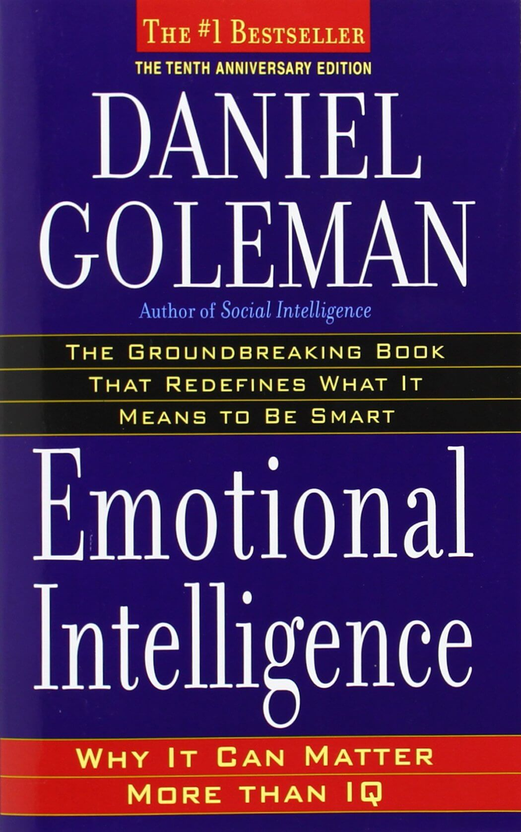
What is ‘Emotional Intelligence’?
A nine-word summary of Daniel Goleman’s bestseller:
Awareness and management of emotions, both yours and others.’
Goleman, Daniel. Emotional intelligence: Why it can matter more than IQ. Bantam, 2012.

Slide 3
Another definition/comparison
Intelligence is the ability to discern and make use of discernment.
Emotional intelligence is the ability to discern emotions and feelings and make use of that.
- Stefan Edmunds

Slide 4
Those with high EQ…
Are self-aware
Have social awareness
Aware of their emotions (easier said than done!)
Understand why they feel the way they do
Have self confidence and optimism
Have empathy for others; observant
Perceived as friendly, approachable
Can ‘read the room’
Have situational awareness
Awareness
Manage their emotions
Have/develop relationships
Demonstrate self-control
Harness (limit) the power of positive (negative) emotions
Are resilient/adaptable
Influence and help others
Help to calm others down
Are good team mates and collaborators
Coach/develop others
Management
Self
Other

Slide 5
A little more detail: Emotions vs Feelings
Trigger
Interpreted as
Cues
Emotions
Feelings
Occasional Hiker (Me)
Snake on a hiking path
Anxiety
Terror/panic
(I hate snakes)
Emotional Intelligence intervenes here
Experienced Hiker
Snake on a hiking path
Anxiety
Calm avoidance

Slide 6
Emotions ➔ Feelings
Emotions | Feelings
Physiological response to cues, that trigger feelings. | Interpreted response to emotions; the meaning we attribute to an emotion.
Example: joy, anxiety | Example: Reaction to joy, anxiety, e.g. happiness, panic
‘Hard-wired’ in our brains | Influenced by beliefs, memories
Comparatively objective—less variant between people | Comparatively subjective—more variant between people
Purpose: Short-term survival | Purpose: Longer-term survival
Brain: Amygdala | Brain: Neo Cortex
Shorter duration | Can be sustained (much) longer

Slide 7
EQ is particularly important in organizations
Why? Because organizations are primarily social spaces
And if organizations are social spaces, then leading them successfully highly favors social competencies, including:
Emotional Intelligence
Communicating
Storytelling
Teamworking
Motivating & Engaging
Social competencies are not a ‘nice to have.’ They are core, not peripheral

Slide 8
A Workplace Example
Cues
Emotions
Feelings
Words/Actions
Lower EQ Manager
Team member misses important deadline—again!
Frustration
Blame
Punitive
Higher EQ Manager
Team member misses important deadline—again!
Frustration, but also…
Empathy
Blame, but also…
Shared responsibility
Assistance
Punitive, perhaps, but also…
Mutual Resolution

Slide 9
EQ is correlated closely and positively with managing and leading successfully.
Star Performers
EQ separates the star performers from the good performers.
r² = 90%!
(Remember your stats class?)
Compared to
Good Performers
Goleman’s¹ Sample: Senior Managers of 188 large, global organizations
(like yours ☺)
¹Goleman, Daniel. Harvard Business Review. Nov/Dec98, Vol. 76 Issue 6, p93-102

Slide 10
EQ is still a potential differentiator—for you and your organization
Historically, management treated as a technical (not social) practice; orgs as machines
It’s changing, but only slowly (see diagram)
EQ is putting back into the core of management practice…
…what shouldn’t have been excluded in the first place.
MBA coursework at most US Universities, by units
90% Technical Coursework
10% Coursework on Social Competencies, e.g. Leadership, Communication, EQ, etc.

Slide 11
Other points of view
“Emotional intelligence is overrated”
  Adam Grant, Ph.D., Univ. of Pennsylvania
  Argues that cognitive abilities are more important for individual performance
  OK, but do you really want to work with or for someone with low EQ?
    Grant’s article
    Goleman’s response
Is there a ‘dark side’ of emotional intelligence? Yes! Manipulation and win-lose/zero-sum approaches
  EQ can be used for ethical or unethical ends
Panacea? Of course not—that’s why you earn a paycheck! ☺

Slide 12

How can I assess my own EQ?
Widely varying views of the efficacy of EQ Assessments
  Critique: Not differentiated from personality assessments; methodological issues; accuracy of self-report design
Assessments
  EQ-i (Author: Barr-On)
  MSCEIT (Author: J. D. Mayer et al)
  Numerous informal assessments available
My view
  Many of these assessments can be useful
  Primary benefit: comparing the results among team members—mutual understanding—this is the payoff
  Perfect accuracy not required. If team members won’t honestly answer self-report instruments, then you’ve got bigger issues to worry about!
  I would not use them as the basis of any performance evaluation, or job assignments

Slide 13
Improving your EQ
Self-awareness
Social awareness
Self-reflection of habits, past over-reactions, trigger cues or words, relationship patterns
Meditation, mindfulness, diary
Practice by observing others’ conversations, body language
First, simply listen (including tone, which may contradict)
‘Checking in’: guess, then ask how they’re feeling
Observe others’ conversations, body language
Awareness
Managing Emotions
Relationships
Walk away
Stress reduction and breating and relaxation techniques
Framing/Re-Framing
Express feelings; confer/confide with friends
Expressing sincere curiosity and interest (networking without making requests!)
Vulnerability
Relational approaches to communication (co-creating of meaning)
Management
Self
Other

Slide 14
Additional Resources
Baron-Cohen, Simon. Reading the Mind in the Eyes.
Bowden, Mark. Winning body language: Control the conversation, command attention, and convey the right message without saying a word. 2015.
Boyatzis, Richard E., et al. "Developing resonant leaders through emotional intelligence, vision and coaching." Organizational Dynamics 42.1 (2013): 17-24.
Bradberry, Travis, and Jean Greaves. Emotional Intelligence 2.0. TalentSmart, 2009.
Consortium for Research on Emotional Intelligence in Organizations
Goleman, Daniel. Emotional intelligence. Bantam, 2006.
Salovey, Peter, and John D. Mayer. "Emotional intelligence." Imagination, cognition and personality 9.3 (1990): 185-211.
Sutton, Robert I. The no asshole rule: Building a civilized workplace and surviving one that isn't. Business Plus, 2007.
UC Berkeley: Facial Recognition Quiz

